Slide 1
Project 3 Good or Bad Loan?
Leo Liu

Slide 2


Objective
Detect risky clients
Improve policies
Notes:
The loan is one of the most important products of the banking. All the banks are trying to figure out effective business strategies to persuade customers to apply their loans. However, there are some customers behave negatively after their application are approved. My model is intended to help bank detect those customers and generate more robust policies.

Slide 3
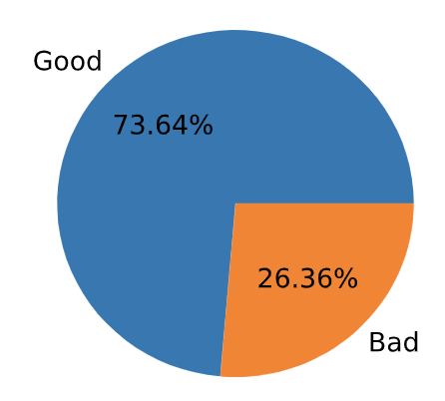

Data Source
Website: Kaggle.com
Overview: Loan data through the 2007-2015
Dimensions: 75 variables, 890k observations
Features: Employment, Income, Homeownership, Credit Scores, Number of Financial Inquiries, Collection among Others.
Notes:
I screened out about 700k rows with loan status as ”current” or “issued”, which cannot be determined as good or bad yet. In the population, there are 50k of bad loans, 150k of good loans. For computational efficiency, I take only a sample of 10,000 data points to train and test my data.

Slide 4
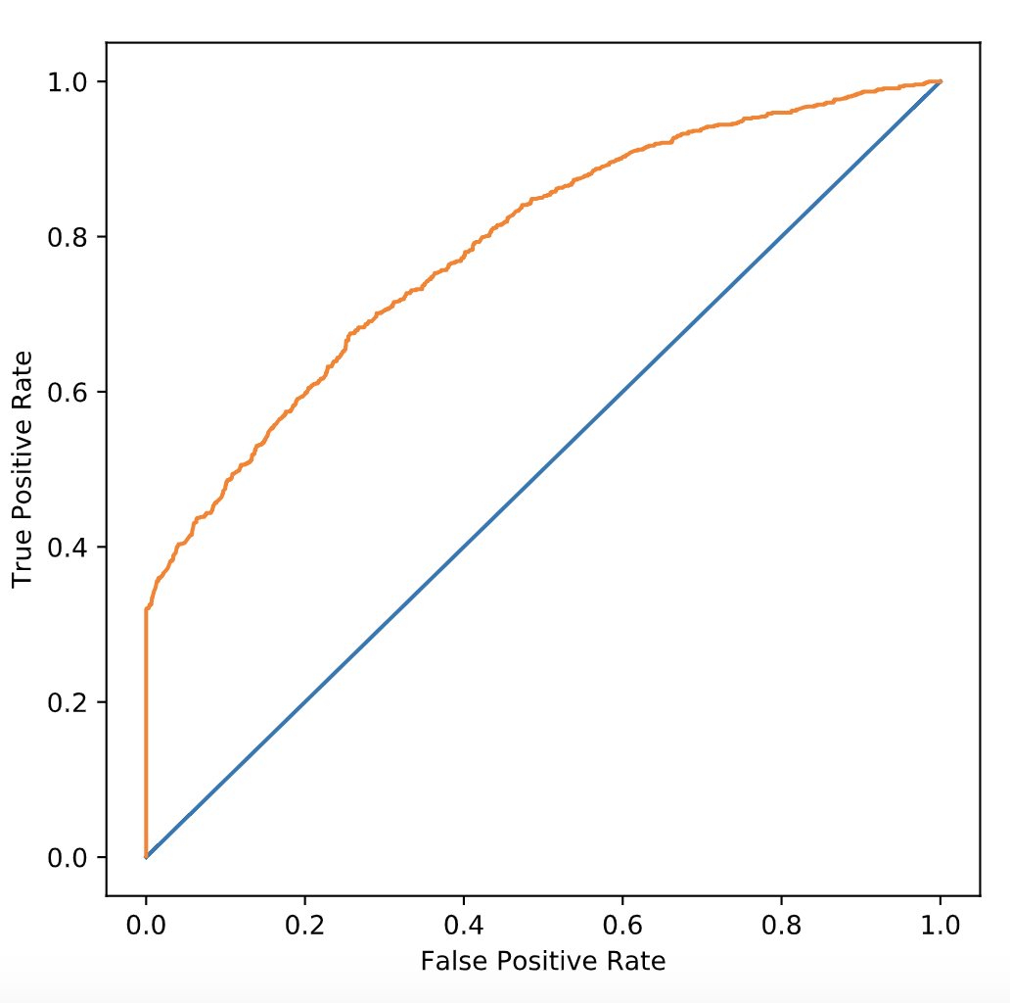
Model
Gradient Boosting Classifier
Classification Report:
Precision: 0.37
Recall: 0.86
f1-score: 0.51
ROC_AUC: 0.79
Notes:
In comparison of all models, Gradient Boosting outperforms others for a better f1-score and a slightly better AUC score. I chose f1-score as my metric in order to detect as many risky clients as possible while avoid turning down good clients. Then I tuned the cutoff to achieve optimal profit.

Slide 5
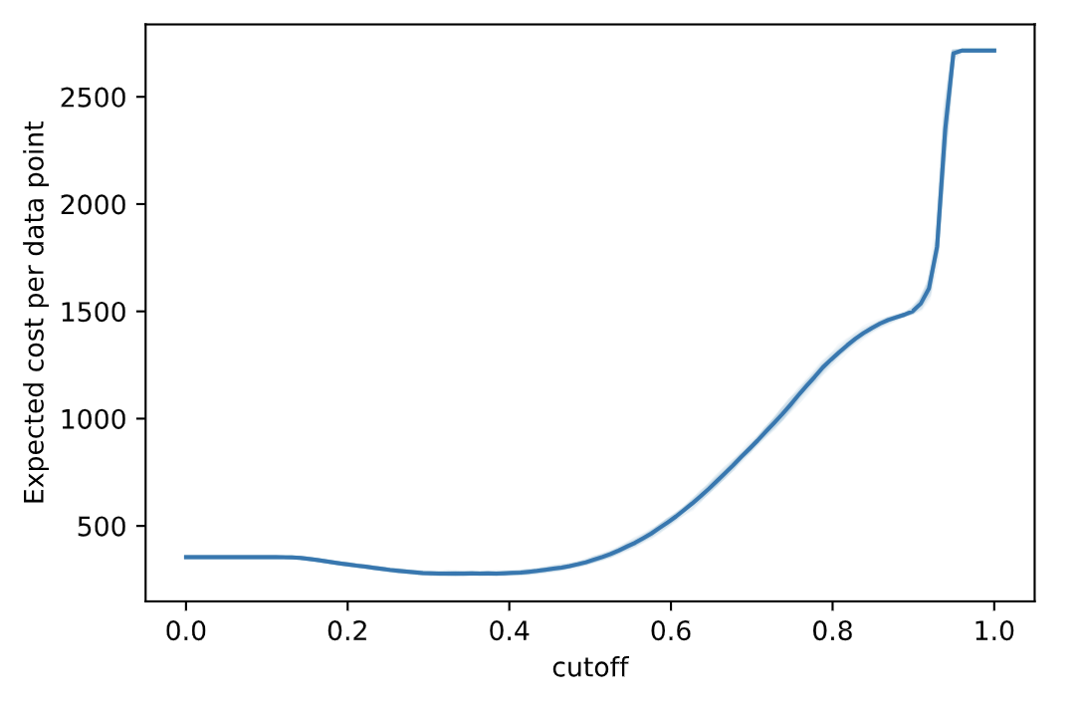
Model
Cost Benefit Analysis
Best Cutoff:
0.38
False Positive Loss: $1,902
False Negative Loss: $0
True Positive Gain: $8,509
Total Savings:
$1082/case
$24M annually
Notes:
This graph shows how expected loss varies with different cutoffs. Then we can see somewhere around 0.4 we reach the minimal cost. After applying true positive gains, it comes out a potential $858 loss per client will be prevented, which sums to $20M savings annually.

Slide 6
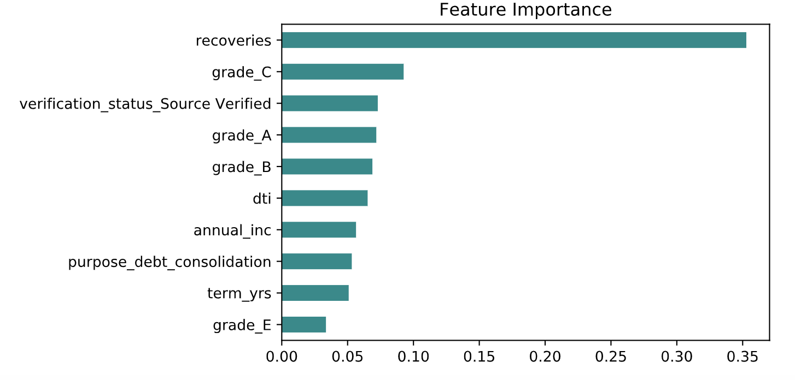
Model
Feature Importance Analysis
Notes:
Feature importance analysis will give bank policy maker some insights to make robust policies. Credit score level, recoveries play great roles in loan quality prediction. Thus, policy maker should focus on those area to mitigate risks of customer negative behaviors. For example, higher installment should be set up for clients with higher recoveries and lower credit scores.

Slide 7
Future Work
Make use of unlabeled rows
Design an application with flask
Analyze bad loan data time wisely
Incorporate more features if available
Run larger scale dataset on AWS machines

Slide 8
Thank You!

Slide 9
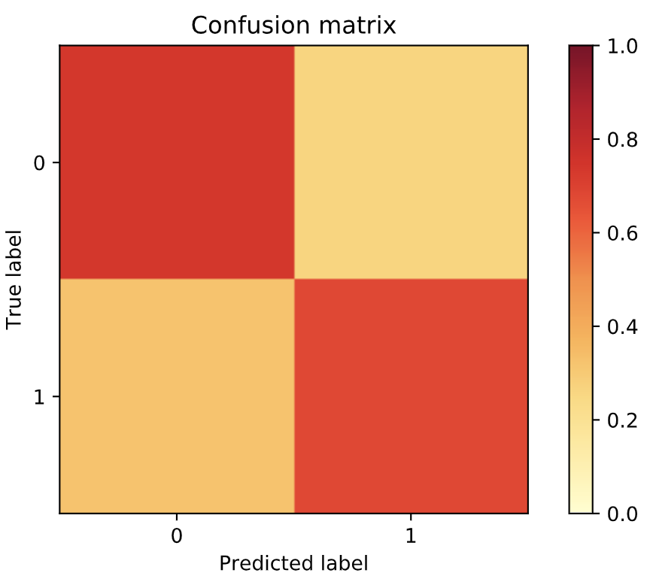
Appendix
Normalized Confusion Matrix(GB)

Slide 10
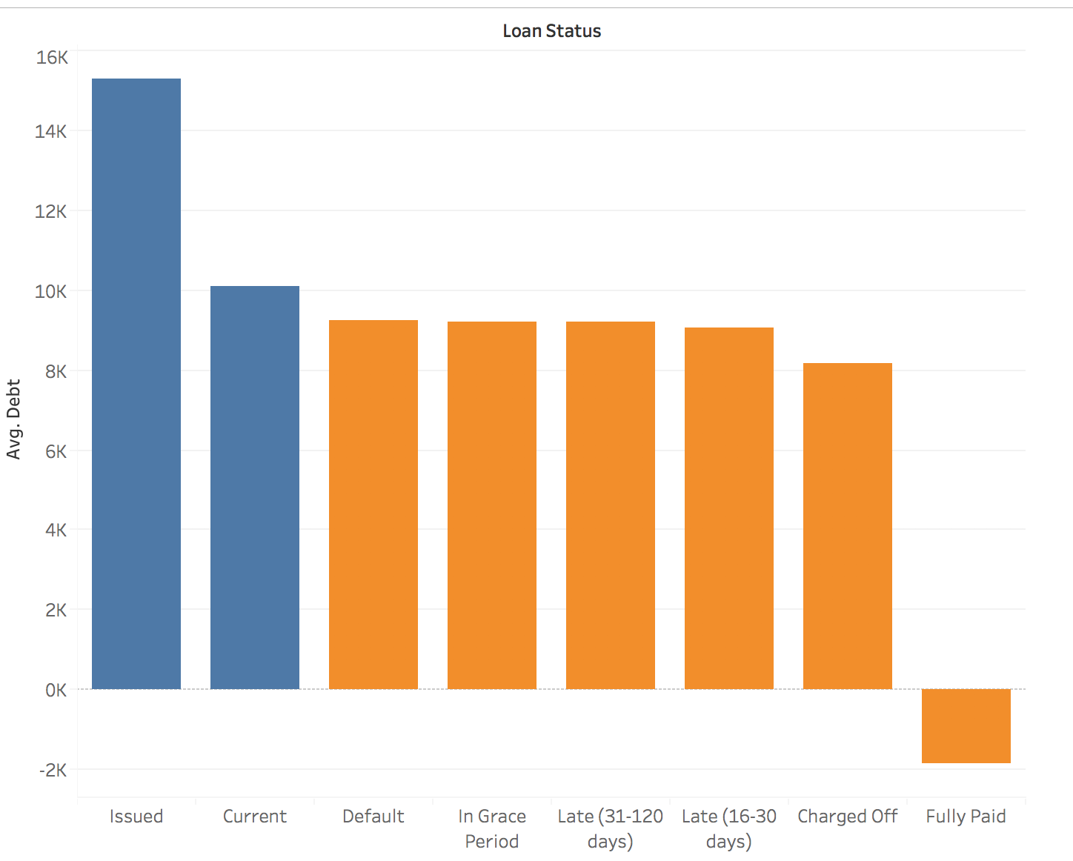
Appendix
Label Data Selection

